Slide 1

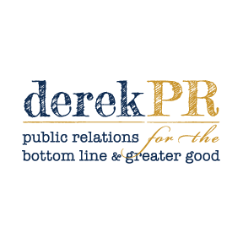
TWENTY YEARS AFTER STARTING WITH A BLANK LEGAL PAD AND A PEN IN AN EMPTY OFFICE, derekPR NOW OPERATES AS A SELECTIVE, SENIOR-LED PUBLIC RELATIONS MODEL WITH A PROVEN RECORD OF CATEGORY-LEADING RESULTS. THIS IS THE WORK. THIS IS HOW IT’S DONE.
I AM MORE OF A STORYTELLER THAN A STATISTICIAN, THOUGH YOU WILL FIND BOTH ON THE PAGES THAT FOLLOW
derekPR operates as a single-lead model, orchestrating cross-functional execution across service providers and agency partners. derekPR maintains a deliberately limited client roster—fewer clients, more attention, better results.
.
ALL RETURN ON INVESTMENT FIGURES, INCLUDING VISIBILITY AND AD EQUIVALENCY, WERE COMMISSIONED BY CLIENTS AND PROVIDED BY INDUSTRY SPECIALISTS.

Slide 2


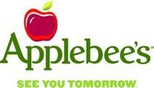

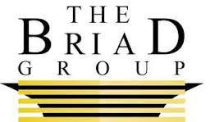


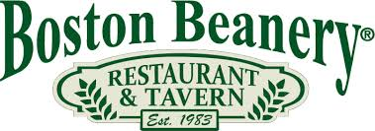



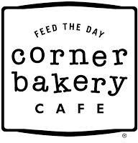







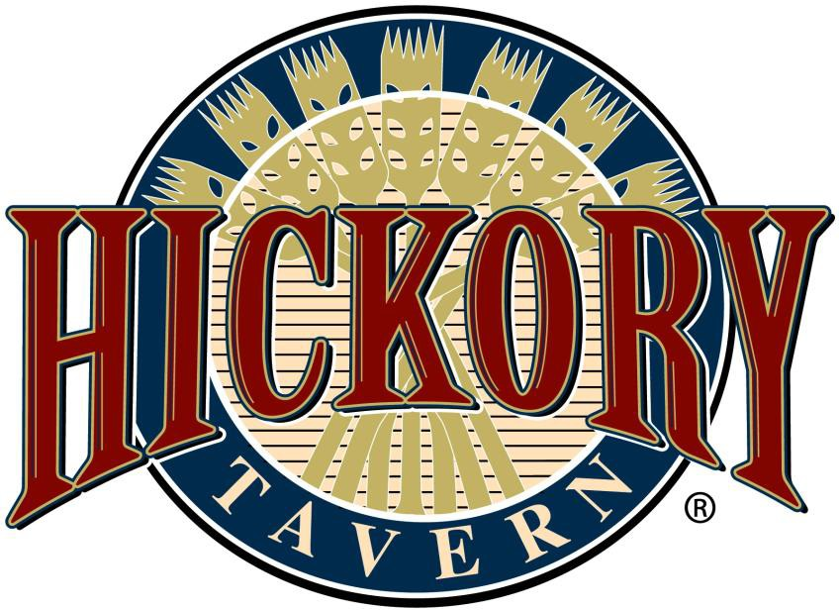
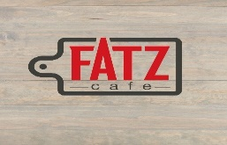



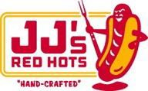

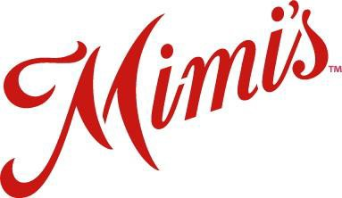
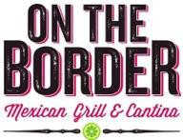
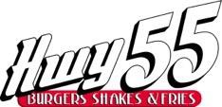
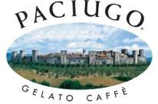







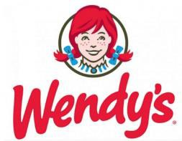
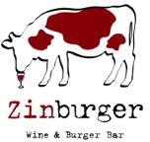

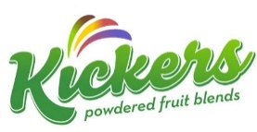
CATEGORY-LEADING RESULTS. DELIVERED REPEATEDLY
The results that derekPR achieved for us were undeniably the best in our company’s history. For the four years during which derekPR was our agency, TGI Fridays led the casual dining industry in both volume and quality of news coverage. Every year.
In addition, we were recognized annually with a record number of best-in-class honors, ranging from Most News Coverage, Most Engaging, Most Creative, Best PR Stunt and Best Return on Investment. We were also awarded Bulldog Reporter’s Top PR Campaign of the Year. He surprised us with that one.
derekPR’s unique business model allowed him to keep our brand top of mind every single day, and I genuinely believe that was the key differentiator behind our PR successes. It is rare to find an agency that can manage both day-to-day needs while exhibiting such creative energy to garner coveted industry awards.
derekPR is simply that good.
Amy Freshwater
SVP Public Relations, Crisis Management, Corporate Communication, Carlson Restaurants Worldwide
TGI Fridays | Agency of Record (4 years)
©2026 derekPR

Slide 3



IN THE NEWS. AS THE EXPERT.
How one restaurant brand responded to a natural disaster
“Our priority was making sure our team members were OK and to do everything possible to help them,” said Derek Farley with derekPR, who emailed responses from the Applebee’s group in Joplin. “Every team member has been accounted for, but many have lost their homes and/or belongings.”
How restaurant chains should handle viral speculation
“My advice is counterintuitive to marketing,” said derekPR’s Derek Farley. “The best way to handle things like this from a PR perspective is to let it ride. If you’re having a winning streak or pitching a perfect game, the last thing you do is start talking about it.”
Secret menus boost buzz at Panera, Taco Bell, McDonald's
Ah, yes, the coolness quotient. “It's there to build an elevated level of affinity to a select few,” says restaurant PR guru Derek Farley. But, he says, there can be a downside. “You may build buzz about your brand," he says, "but I'd rather sell something that appeals to a lot than a few.”
Consumers are demanding more mobile meal options.
“American diners suffer from an extreme case of impatience and have an insatiable need for convenience that only technology can cure,” says restaurant industry publicist Derek Farley of derekPR.
Free meals to veterans give restaurants a PR boost
“It's good food meets goodwill,” says Derek Farley, president of restaurant PR chain derekPR. ”There are 24 million veterans and troops, and they all remember who feeds them for free on their day of respect.”
Pizza Hut deal gets you a $5.55 pizza.
“If the consumer needs something that gives them permission to experiment with a brand, $5 is the magic number," says Farley. "It is consistently the threshold that reinforces the idea of a deal.”
Halloween freebies are a growing trend among restaurants.
“Just don’t. Restaurants are like ghost towns on Halloween,” says Derek Farley, a restaurant industry PR guru. Much like Labor Day and July 4th, Halloween is a holiday that's not very restaurant-friendly, he says.
Fast-food deals go a long way in January.
“The challenge is to convince the consumer that the deal is so good that it simply cannot be passed up," says Derek Farley, president of derekPR, a restaurant specialty public relations firm, who notes that many big restaurant chains typically see sales drop about 3% in January vs. an average month. "Dining is the first and easiest thing to resist when you're being cautious with your wallet and your gut.”
©2026 derekPR

Slide 4
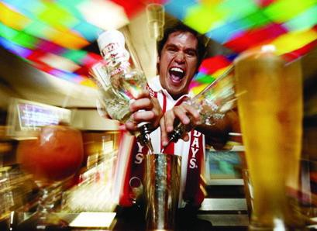
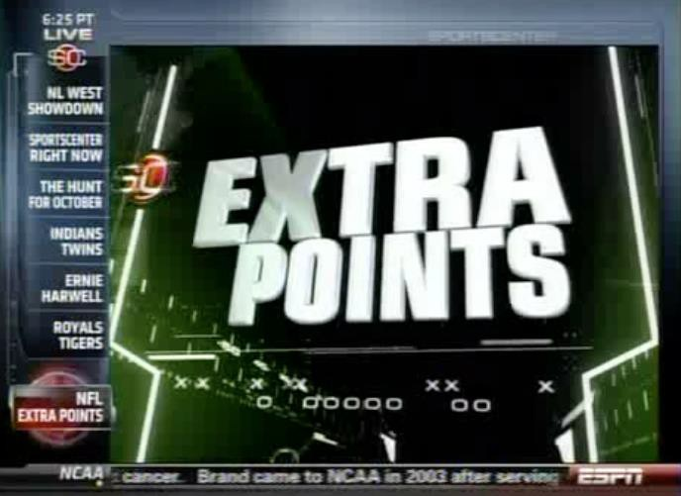

TGI Fridays | Agency of Record
Agency of Record for TGI Fridays for more than four years
Retained to establish category leadership for media relations and public relations
Delivered the best news coverage in the brand's history, outperforming brands two and three times its size
In its first project with derekPR, TGI Fridays was recognized with the coveted industry award, Most News Coverage, an award sought across all industries and all classes of competition
During the partnership, TGI Fridays also won the following national public relations awards:
      Most Creative Campaign
      Best Reaction to Breaking News
      Best Return on Investment
      Most Engaging Campaign
      Best PR Stunt
An unplanned, one-day campaign created and executed by derekPR earned the industry’s top honor: Best Overall PR Campaign of the Year
»

Slide 5
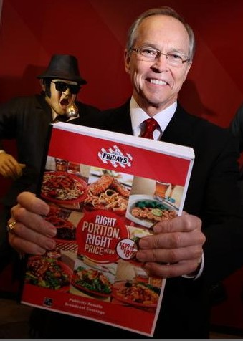
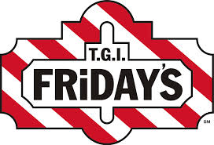
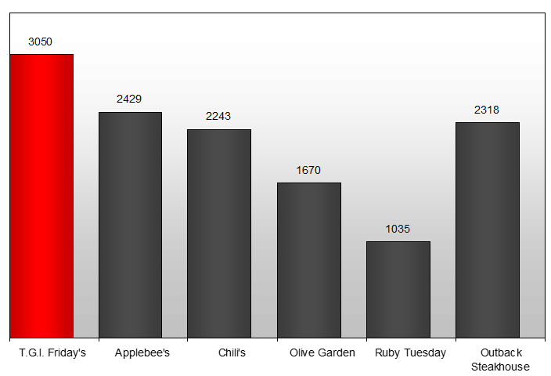
#1 IN STORY COUNT
FOUR YEARS IN A ROW
WINNER | MOST NEWS COVERAGE

Slide 6
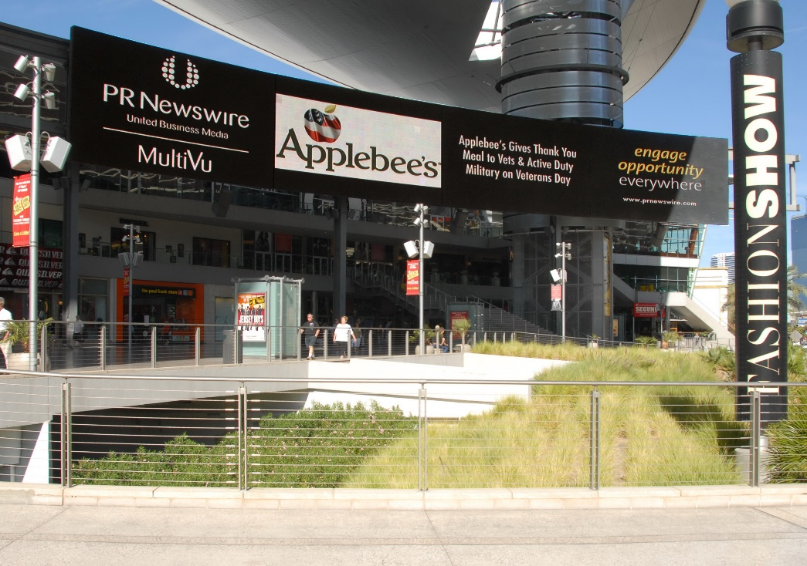
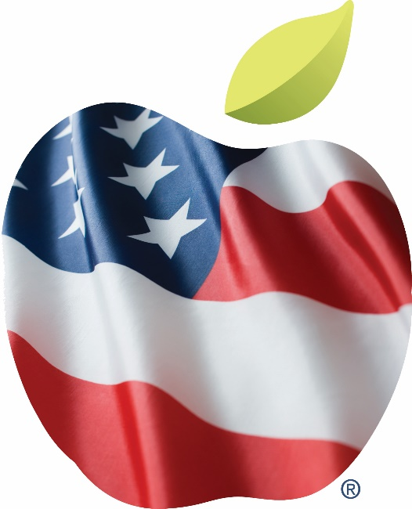
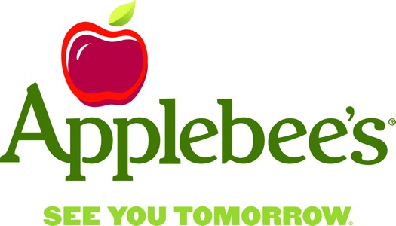
Applebee’s | Agency of Record
Agency of Record for two years; ongoing representation of multiple franchise partners within the Applebee’s system
Retained to restore category leadership in several key PR measurement metrics, exceeded all performance targets
Increased earned media performance in year two across multiple campaigns; advertising equivalency increased 39 percent over the partnership
Secured placement in 100% of Veterans Day coverage in 2010—the only brand to achieve that level of saturation
Improved positive news tonality from 48% to 76%, moving from below to above the 66% industry average
Transformed a one-day Veterans Day initiative into a year-round platform (The Thank You Movement), earning the Most Creative Campaign Overall by the League of American Communications Professionals during the launch year
Orchestrated a USA Today front-page story for its Under 550-Calories menu, managing all multimedia assets and interviews on-site
©2023 derekPR
©2023 derekPR

Slide 7
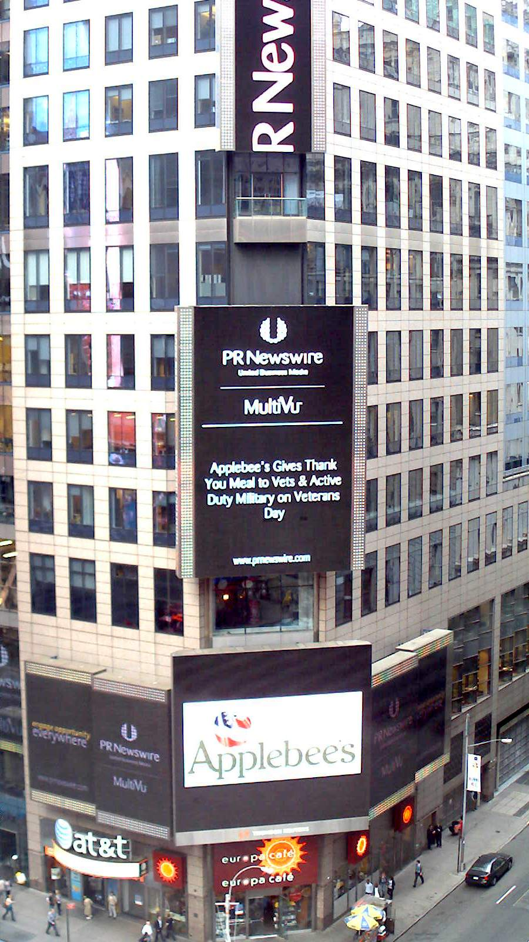
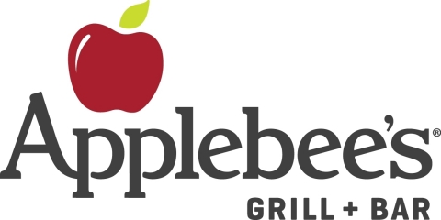
APPLEBEE’S DOMINATED AD EQUIVALENCY VIA
EARNED MEDIA COVERAGE UNDER derekPR

Slide 8
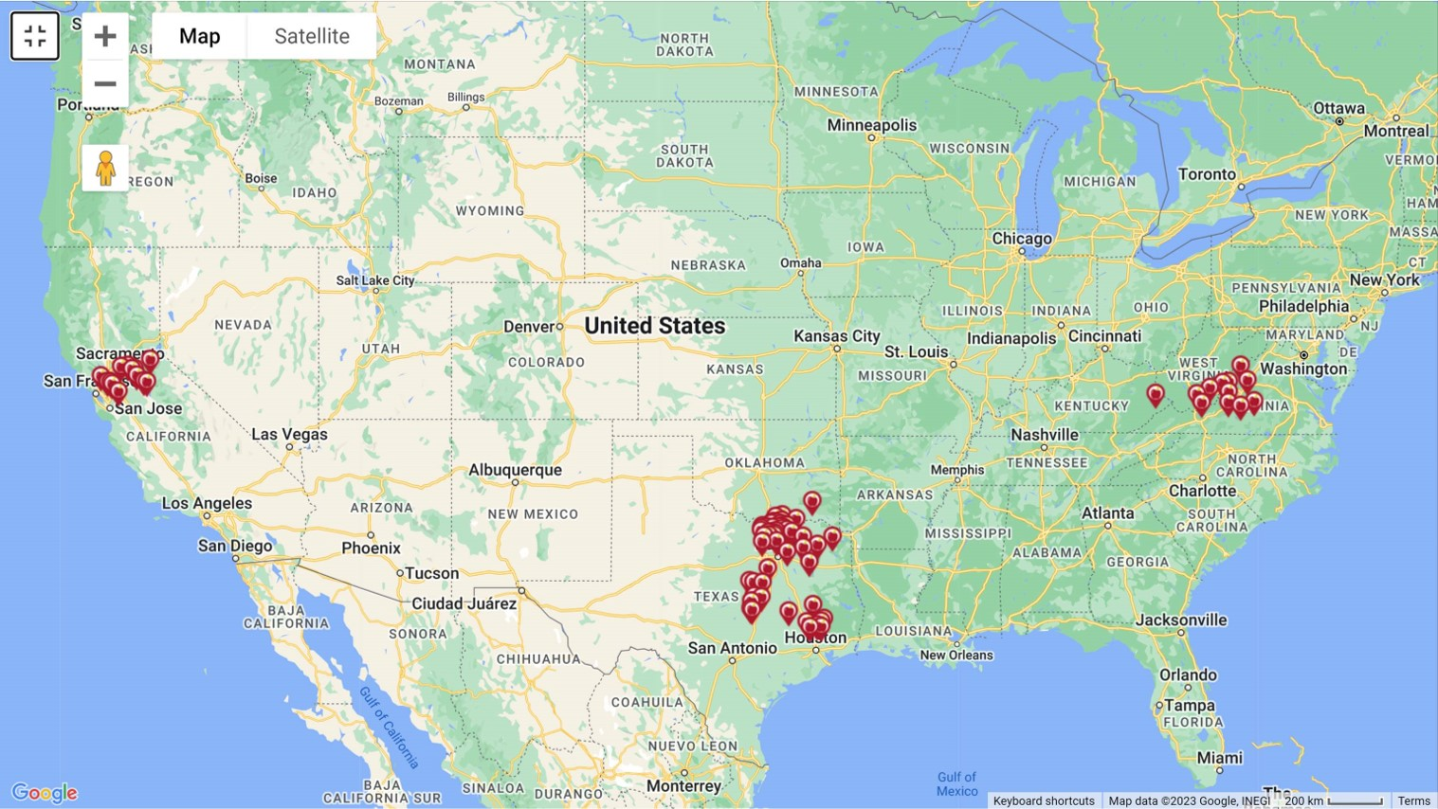


SSCP Management | Franchise Partner Strategy
Long-term PR partner to SSCP Management, one of Applebee’s largest franchise groups (10+ year relationship)
Retained with three objectives:
Build hyperlocal media networks across all SSCP markets
Drive PR for SSCP-specific campaigns beyond national initiatives
Elevate SSCP within the Applebee’s franchise system through PR performance
Built and manages media relationships across 10 DMAs, including 26 network affiliates and 284 local outlets
Delivered an 11:1 earned media ROI and 26% higher positive coverage than non-SSCP Applebee’s locations
Earned:
Bill Palmer Heart of Applebee’s award, named after the brand’s founder, for its commitment to a specific cause or organization
Marketer of the Year award, for marketing and media excellence within the respective franchise partner community
©2023 derekPR
©2023 derekPR

Slide 9
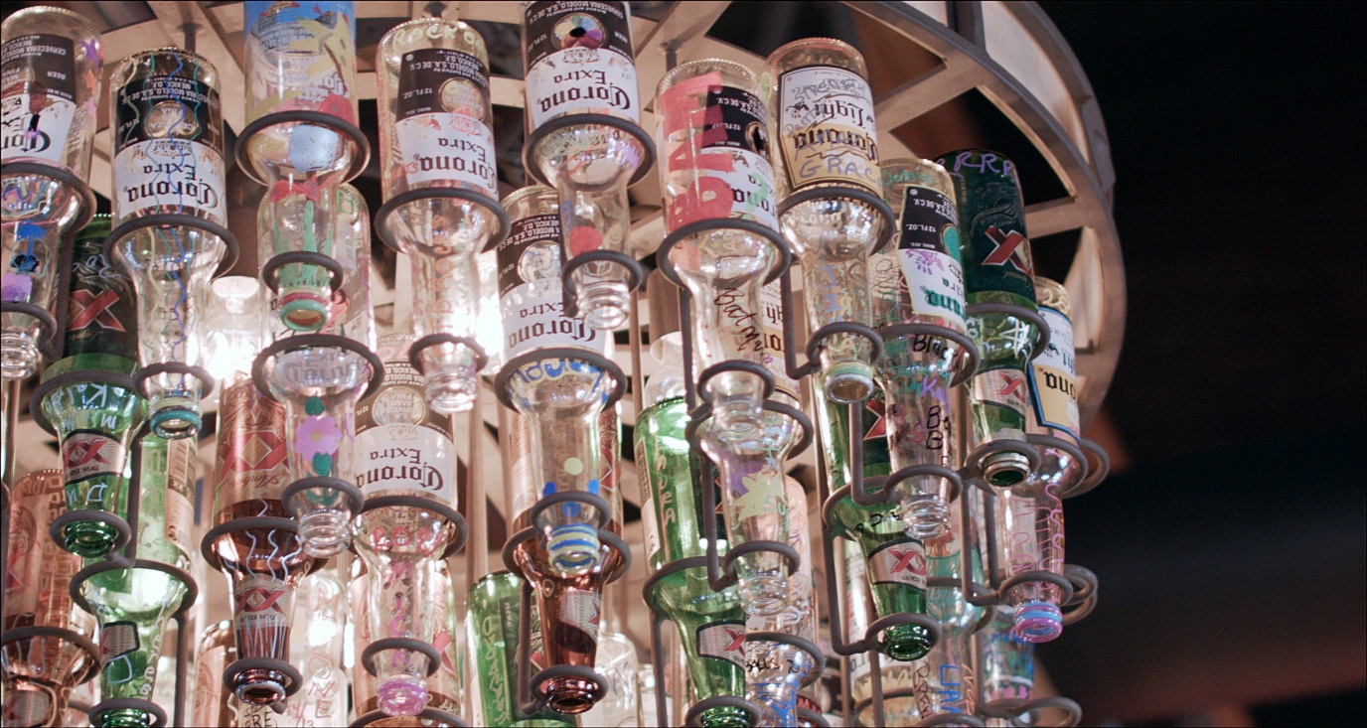
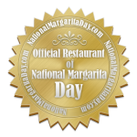
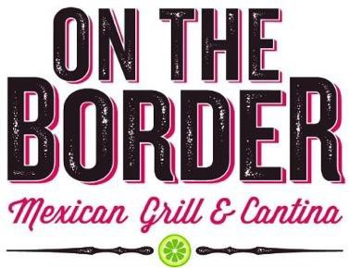
ON THE BORDER | Turning Brand Assets into Revenue + Community + Media Coverage
First PR agency of record; established On The Border as the Official Restaurant of National Margarita Day
Extended that platform across brand-centric holidays, driving sustained comp growth:
National Margarita Day (+25%)
National Tequila Day (+24.2%)
Veterans Day (+ 26%)
Cinco de Mayo (+21%)
Increased overall news coverage by 42%
Delivered 94% positive news tonality vs. 68% industry average
Activated an overlooked in-store asset—the signature bottle chandelier—as a revenue and PR driver during 8 re-openings
Sold 230 bottles at $100 each; generated $23,000 for local charities
Converted a static brand element into a story with community impact
Took something every guest saw and turned it into something everyone talked about.
©2026 derekPR
©2023 derekPR

Slide 10
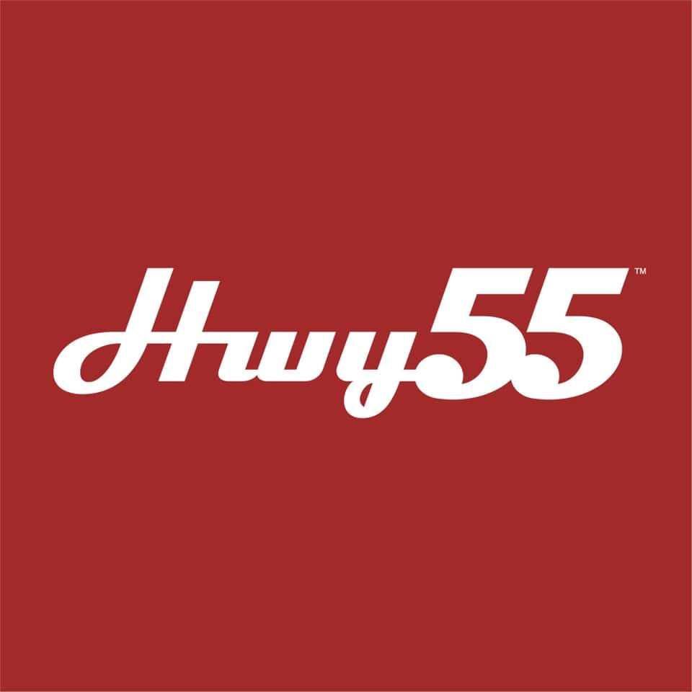
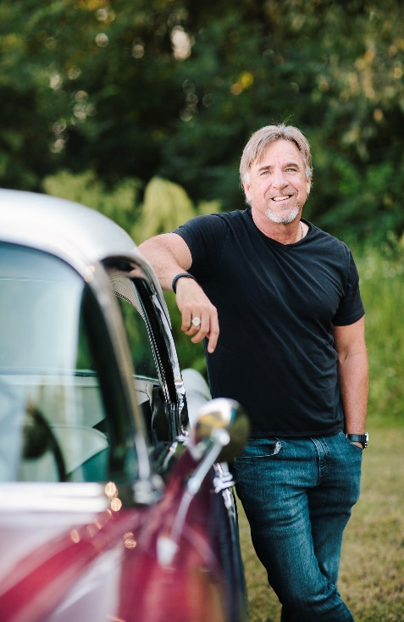
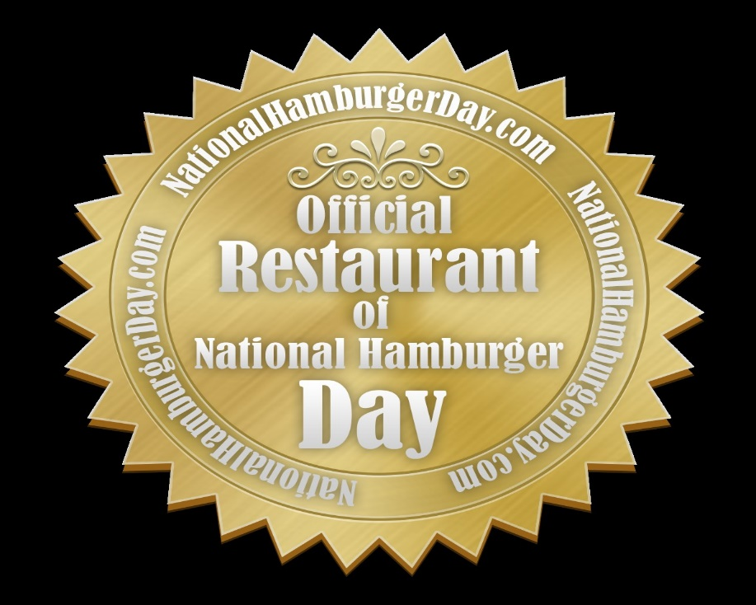
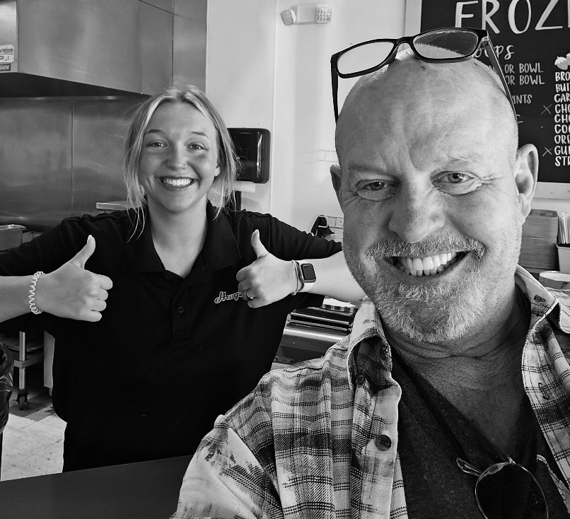
HWY 55 | Turning a Regional Brand into a National PR Platform
First PR agency of record; transformed an internal morale event (World Hamburger Eating Championship) into a national, press-generating brand platform
Built a hyperlocal media system across all Hwy 55 markets:
Increased news coverage by 52%
Achieved 86% positive tonality
Established recurring TV presence (average 2 segments per quarter)
Expanded brand storytelling beyond core markets:
Secured coverage in key industry outlets (Service Restaurant, Burger Business) aligned with franchising growth objectives
Developed culturally relevant, news-driven campaigns (National Hot Dog Day, Virginia Tech tribute), earning national sports and local broadcast coverage
Positioned Hwy 55 as a national brand:
Delivered PR performance comparable to brands 2-3x its size
Secured designation of the Official Restaurant of National Hamburger Day

Slide 11
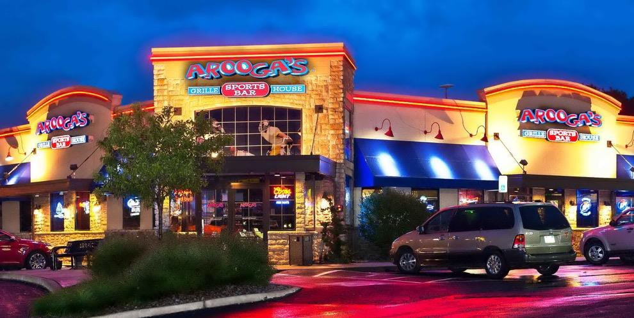
derekPR | Delivering Record PR Performance from Day 1
HICKORY TAVERN | IMMEDIATE MARKET IMPACT
Delivered the highest PR return in brand history within the first 90 days:
Generated record media value for the brand
Secured consistent network TV coverage tied to the Carolina Panthers’ Super Bowl run
Activate local momentum and in-market engagement
Led VIP launch events generating 200+ attendees and extensive local media coverage
Created culturally relevant promotions (March Madness campaign), driving traffic and buzz
AROOGA’S | HIGH IMPACT LAUNCH EXECUTION
Delivered record-setting return on first engagement
Generated $25K+ in media value in the first month, surpassing the annual retainer
Turned a hometown Best Wings story into a philanthropic activation supporting a vandalized soup kitchen
Converted local story into multi-market visibility:
Secured coverage across all four local network affiliates, with repeat placements
Supported brand momentum during recognition as America’s Next Top Restaurant Franchise

Slide 12
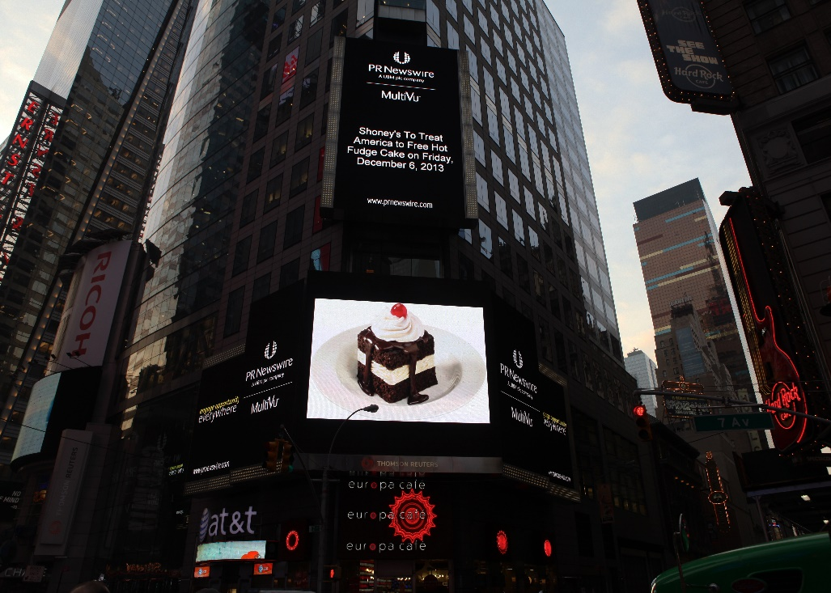
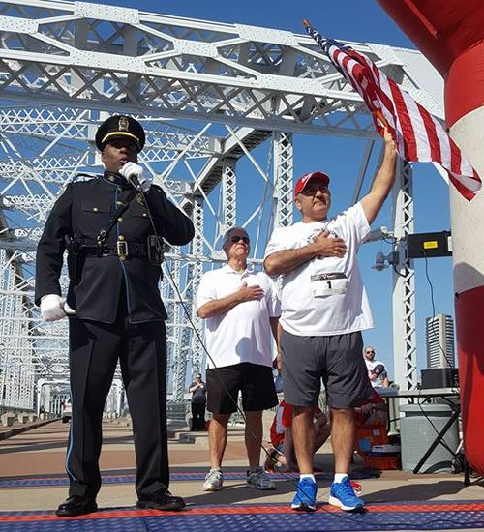
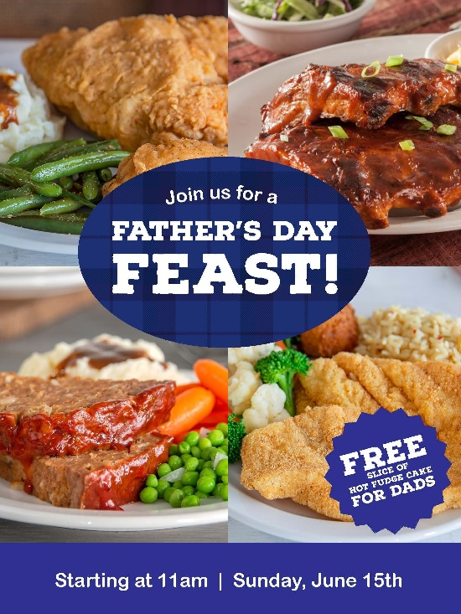

SHONEY’S | Rebuilding Reputation and Category-Leading PR Performance
Implemented a hyperlocal media system across all Shoney’s markets
Increased news coverage by 113% within the first two years
Re-established consistent presence in major media, including USA Today and The Wall Street Journal
Sustained long-term brand relevance through disciplined PR execution
Maintained 92% positive news tonality, among the highest in family dining
Averaged 100+ independent news placements annually
Repositioned Shoney’s as a consistent source of community-driven news
Established the brand as a go-to for local media across its footprint
Delivered ongoing earned media value year over year
Turned a dormant brand into a consistent media presence – and keeps it there

Slide 13
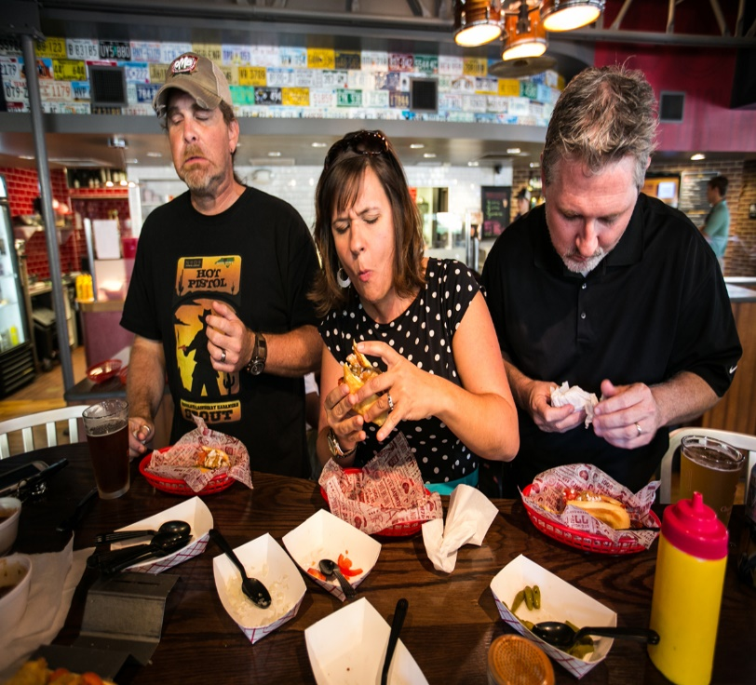
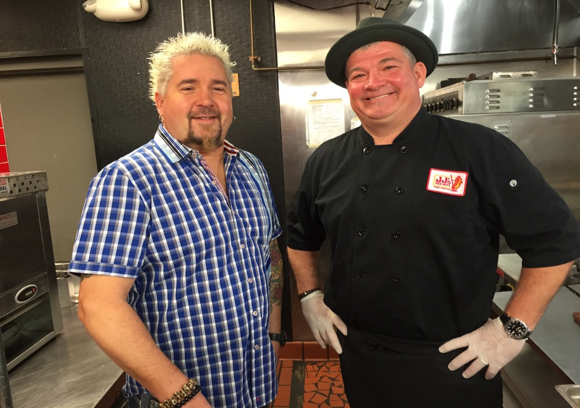
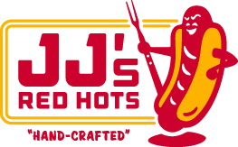
JJ’S RED HOTS |Building National Recognition for a One-Unit Brand
Took on a single-unit brand and built a national media presence from the ground up
Secured consistent local and regional coverage, including The Charlotte Observer and network affiliates
Earned several nationally-placed stories, including USA Today and Time
Delivered breakthrough national recognition:
Earned feature placement on Food Network’s Diners, Drive-Ins and Dives
Generated $5M in advertising equivalency from the appearance
Producer: “I’ve never seen a smaller brand with more national attention and PR”
Sustained category-leading credibility over time:
Named to Fast Casual’s Movers & Shakers list twice
PR Campaigns ranked nationally against industry stalwarts
Won all local “Best Hot Dog” awards in the Charlotte market
Maintained consistent recognition in regional and national publications
Built a nationally-recognized brand without scale – and proved it could compete with anyone

Slide 14
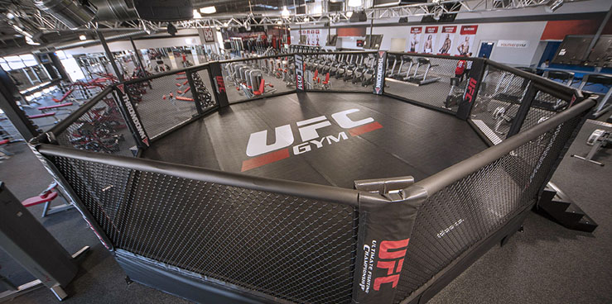

UFC GYM | Building a Scalable PR Engine for Rapid Franchise Growth
Built a repeatable PR model for new location openings:
Supported 5-6 openings per month across multiple markets
Secured consistent local and regional coverage for every launch
Drove national visibility through campaign-led storytelling:
Activated a Father’s Day campaign offering free fitness access for dads, generating 30+ media placements
Earned coverage in top-tier outlets, including Time and USA Today, along with national broadcast segments
Delivered business impact at scale:
Contributed to record-breaking sales performance during grand openings
Supported brand momentum during a period that led to a $4B UFC acquisition
Turned franchise expansion into a repeatable media event

Slide 15
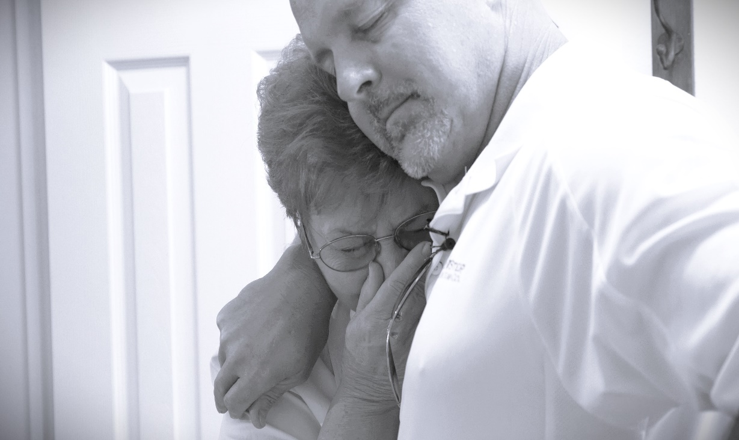
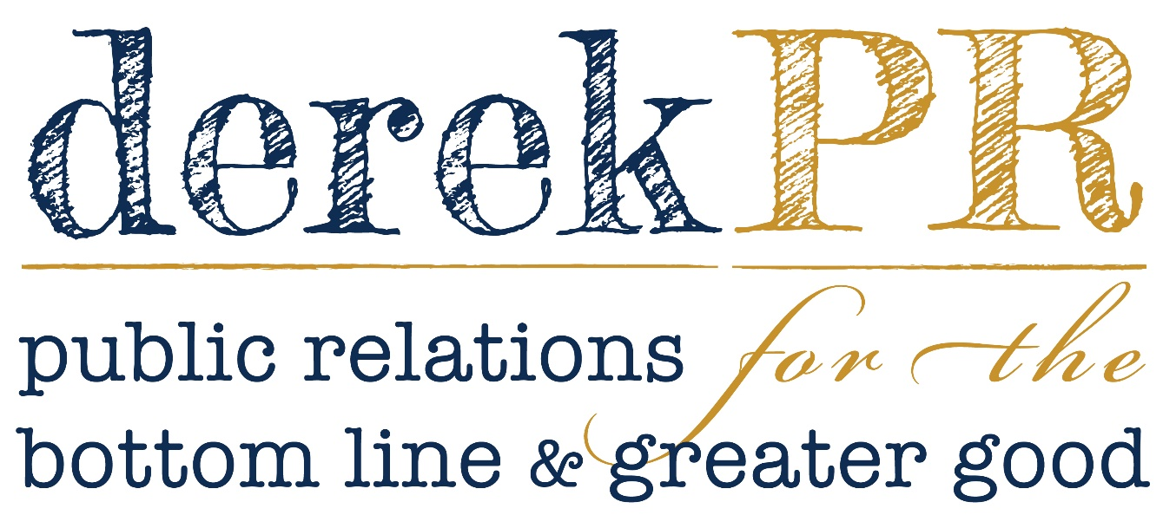
derekPR | How I Deliver Results
Scale without losing control
Build hyperlocal media networks across
Maintain consistency, quality, and message discipline across markets
Sustain performance—not spikes
Deliver category-leading results year over year
Maintain high-volume, high-quality coverage with consistent positive tone
Structured to outperform
Senior-led with single-point accountability
Selective roster: fewer clients, more attention, stronger results
Start fast. Prove value immediately
Deliver record PR performance from the first engagement
Establish immediate media presence and credibility
Turn moments into platforms
Convert single stories into repeatable, multi-market coverage
Extend campaigns beyond one moment into sustained brand narratives
PROVEN ACROSS NATIONAL BRANDS, FRANCHISE SYSTEMS AND SINGLE-UNIT OPERATORS

Slide 16



















AWARDS | ONE STORY
Some people think awards are for the industry. I never did; in my first year, I went to the PR equivalent of the Oscars.
I wasn’t invited—I bought a seat because I thought that’s what you were supposed to do.
The next year, I was invited. Travel covered. No expectations; I didn’t know why I was there—until I heard my name.
I had submitted a campaign for TGI Friday’s without telling them. It wasn’t in the budget.
It didn’t require operations. It was just an idea.
They had already won everything that mattered that year.
This one was different. This one was mine.
When they announced the grand prize, I heard someone at the table say, “Who the hell is Derek Farley?” Then they called my name.
I stood up, said “that’s me,” took the award, thanked the back table, and left.
©2026 derekPR

Slide 17
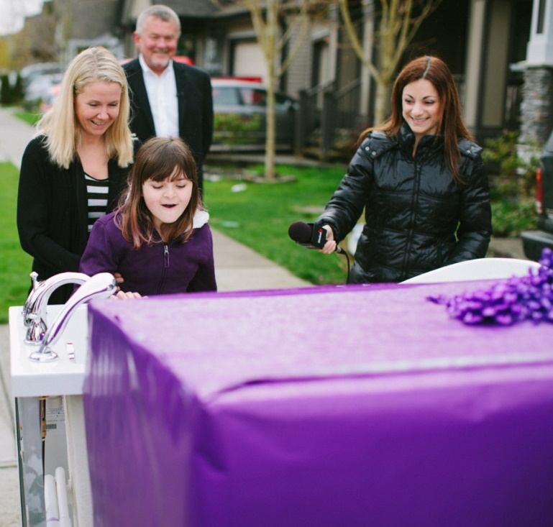
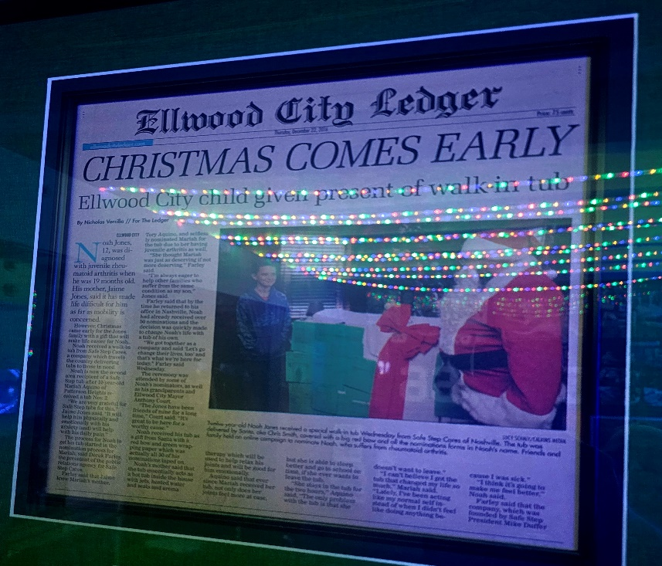

SAFE STEP CARES | Scaling community impact
with Dignity-First PR
Led with discipline—what we didn’t do mattered:
Avoided self-serving storytelling around recipients
Prioritized dignity over exposure in every activation
Ensured coverage elevated the cause—not the brand
Built internal alignment around purpose-driven PR
Proved community impact and strong PR performance don’t have to compete
Built and sustained a community-driven PR platform:
Sustained multi-year charitable giving program
Executed 60+ donations across local communities
Maintained 100% positive news tonality across all coverage
Generated 90 network TV segments and $1.7M in media value (7:1 ROI)

